Slide 1
INTERACTION ABSTRACT MACHINE
GROUP 7
Kayode, Peter Temitope - 208077
Akinrinola, Blessing Opemipo - 214857
Olalere, Khadijat Titilayo - 222502
Okumagba, Oghenerukevwe Miracle - 222498
Chinedu, Promise Okafor - 213930

Slide 2
TABLE OF CONTENTS
01
Introduction
02
Components of IAM
03
Programming Examples
04
Real Life Applications
05
Challenges and Solutions
06
Future Directions

Slide 3
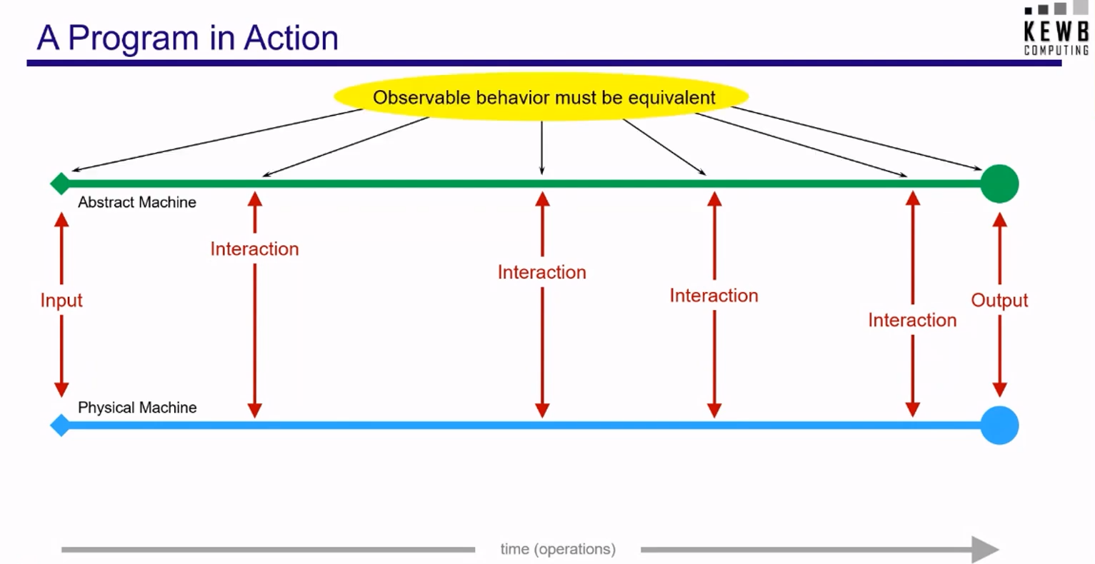
Introduction
to Interaction Abstract
Machines (IAM)

Slide 4
INTRODUCTION TO IAM
The Interaction Abstract Machine (IAM) is a theoretical model of computation that focuses on the interactions between agents or entities within a system. It provides a framework for understanding and analyzing complex systems where interactions play a crucial role.
IAM emphasizes the interaction between computational entities rather than the internal state of individual components. It provides a framework for understanding how complex systems emerge from the interplay of simpler elements.

Slide 5
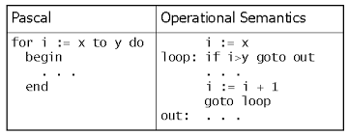
INTRODUCTION TO IAM
IAM is crucial for defining operational semantics, guiding compiler/interpreter design, and analyzing program execution in functional languages.

Slide 6
WHAT PROMPTED IAM?
The development of IAM was motivated by the need for a more expressive and flexible model than traditional sequential programming languages. These languages often struggle to represent concurrent and distributed systems where interactions between components are essential.
IAM began to gain prominence in the late 1980s and early 1990s as researchers sought to address the limitations of existing models for representing and analyzing complex systems.

Slide 7
AIM OF IAM
The primary purpose of IAM is to provide a formal framework for modeling and analyzing systems that involve interactions between entities. It aims to:
Represent complex systems: IAM can represent systems with a large number of interacting entities and complex relationships between them.
Analyze system behavior: IAM can be used to analyze the behavior of a system, identify potential problems, and evaluate different design options.
Design and develop systems: IAM can be used as a tool for designing and developing new systems, ensuring that they are well-structured and efficient.

Slide 8

Comparison between IAM and other types of abstract machine
(e.g. Turing machine, Lambda calculus, FSM, and PDA)
Computational Power
State Representation
Programming Paradigms
IAM
Formal Verification
Interaction vs. Transformation
Concurrency and Parallelism
Compositionality

Slide 9
IAM AS A MODEL OF COMPUTATION
IAM can be viewed as a general model of computation that can be applied to various programming paradigms. In this context, agents can represent:
Variables: Agents that store and manipulate values.
Functions: Agents that perform computations and interact with other agents.
Data Structures: Agents that represent collections of data, such as arrays, linked lists, or trees

Slide 10
IAM AS A MODEL OF COMPUTATION
Interactions between agents can represent:
Assignment: An agent (variable) receives a value from another agent (expression).
Function Calls: An agent (function) interacts with other agents (parameters) to perform a computation and returns a result.
Data Structure Operations: Agents (data structures) interact with other agents (elements) to add, remove, or modify elements.

Slide 11
IAM NOTATIONS
Agent: A, B, C, ...
Interaction: a, b, c, ...
Channel: c1, c2, c3, ...
Protocol: π
Parallel Composition: P | Q
Input: a(x).P
Output: a<e>.P
Restriction: νa.P

Slide 12
A Simple IAM System
Consider a system with two agents, A and B, and a channel c. The system can be represented as:
P = (a(x).B | b<y>.A) | c(z).A
This expression means that A can input a value on channel a and become B, and B can output a value on channel b and become A. Additionally, both A and B can input a value on channel c and remain A.

Slide 13
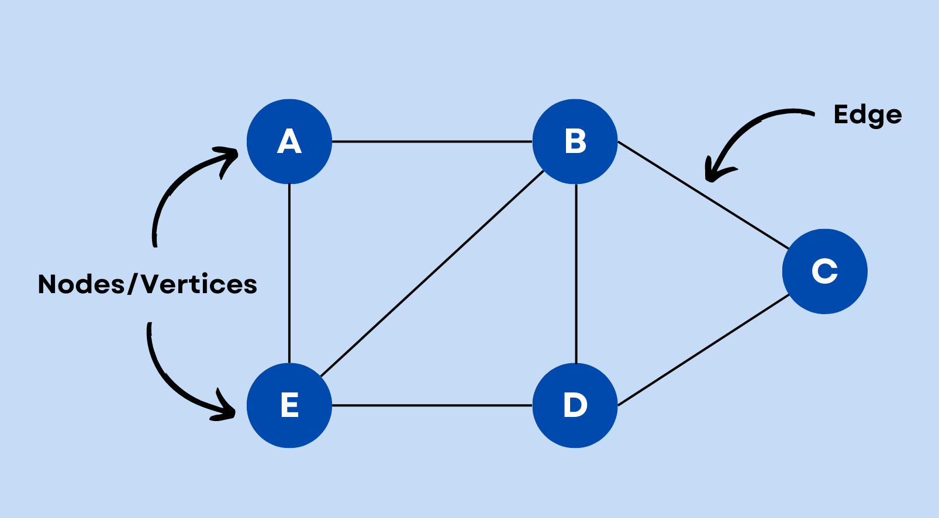
Graph Representation of IAM
An IAM is typically represented as a graph. The graph can be directed or undirected, depending on the nature of the interactions.
Nodes: Represent agents (variables, functions, data structures).
Edges: Represent interactions between agents.

Slide 14
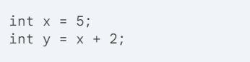
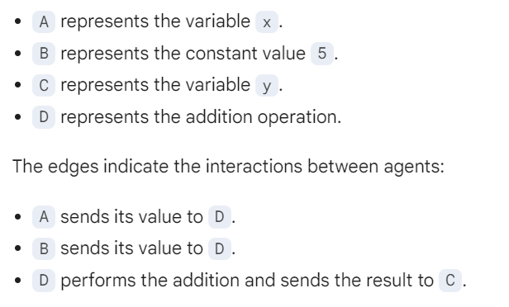
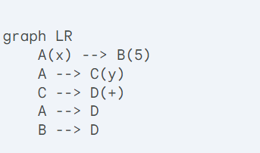
Examples and Their IAM Representations

Slide 15
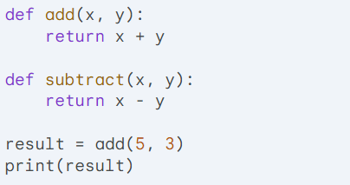
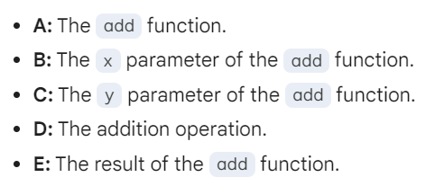
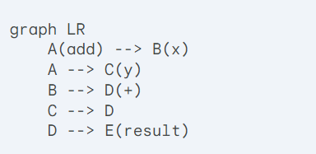
Examples and Their IAM Representations

Slide 16
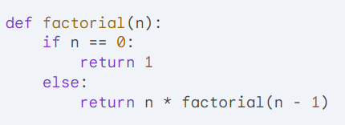
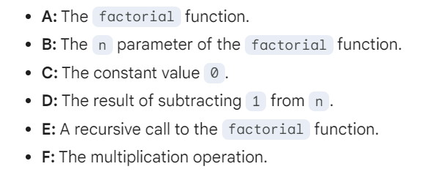
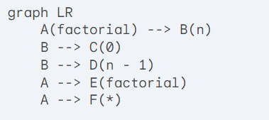
Examples and Their IAM Representations

Slide 17
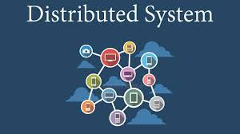
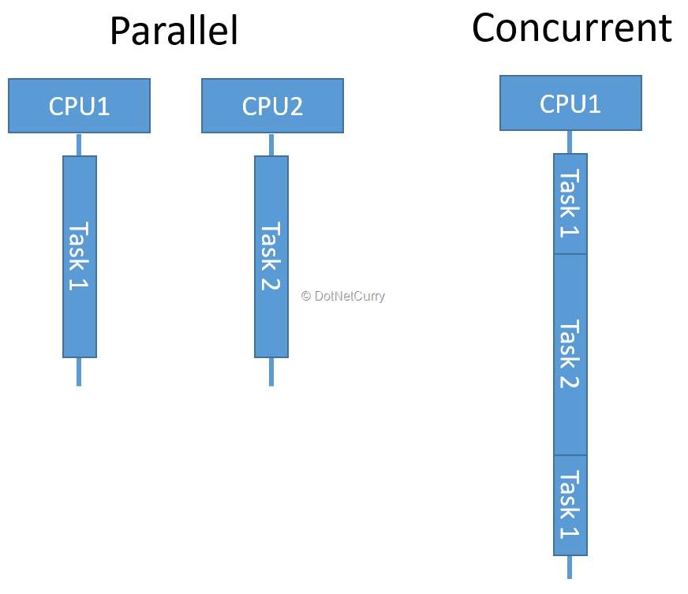
Practical Examples of IAM
Distributed Systems
Microservices Architecture: IAM can model the interactions between microservices, ensuring that they communicate effectively and efficiently.
Cloud Computing: IAM can be used to analyze the interactions between virtual machines, storage devices, and other resources in a cloud environment.
Internet of Things (IoT): IAM can model the interactions between IoT devices, gateways, and cloud platforms.
Concurrent Programming
Operating Systems: IAM can model the interactions between processes and threads within an operating system.
Concurrency Libraries: IAM can be used to design and analyze concurrency libraries, such as those for parallel programming or actor-based systems.

Slide 18

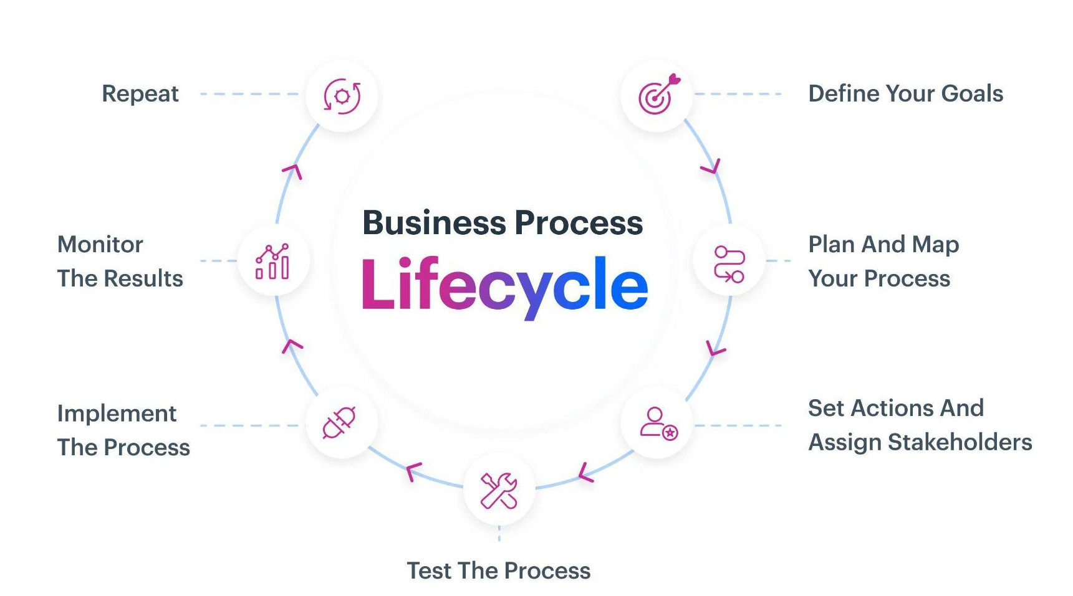
Practical Examples of IAM
Real-Time Systems
Autonomous Vehicles: IAM can model the interactions between sensors, actuators, and control systems in autonomous vehicles.
Industrial Automation: IAM can be used to design and analyze real-time control systems for industrial processes.
Business Processes
Workflow Management: IAM can model the interactions between tasks, actors, and data in a workflow process.
Supply Chain Management: IAM can be used to analyze the interactions between suppliers, manufacturers, distributors, and customers in a supply chain.

Slide 19
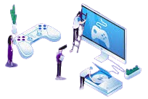
Practical Examples of IAM Cont’d
Other Applications
Social Networks: IAM can model the interactions between users, posts, and comments in a social network.
Game Development: IAM can be used to design and analyze the interactions between players, game objects, and the game environment.
Financial Systems: IAM can model the interactions between financial institutions, customers, and transactions.

Slide 20
ANALYZING IAM
Analyzing IAM systems involves understanding the behavior, properties, and performance of these systems
1. Model Checking:
Formal Verification: Using tools like SPIN or NuSMV to verify the correctness of IAM models against specific properties (e.g., safety, liveness).
2. Simulation:
Scenario Analysis: Simulating different scenarios to evaluate the system's behavior under various conditions.
Performance Evaluation: Measuring the system's performance metrics, such as response time, throughput, or resource utilization.
3. Static Analysis:
Code Analysis: Analyzing the source code of IAM systems to identify potential issues, such as deadlocks, race conditions, or security vulnerabilities.

Slide 21
ANALYZING IAM (cont’d)
4. Performance Profiling:
Instrumentation: Inserting code into the system to measure performance metrics.
Bottleneck Identification: Identifying the parts of the system that are causing performance bottlenecks.
Example: Profiling a distributed system to identify the slowest components and optimize them.
5. Testing:
Unit Testing: Testing individual components of the system to ensure they function correctly.
Integration Testing: Testing the interactions between different components of the system.
System Testing: Testing the entire system to ensure it meets its requirements.
6. Model Transformation:
Refining Models: Transforming IAM models into more detailed or abstract representations.
Comparing Models: Comparing different IAM models to identify similarities and differences.

Slide 22
ANALYZING IAM (cont’d)
7. Visualization:
Graph Visualization: Visualizing IAM models as graphs to understand the structure and relationships between agents and interactions.
Simulation Visualization: Visualizing the execution of IAM models to observe the system's behavior over time.

Slide 23
Thank you

